Slide 1
Construction and Application of Small Portable Low Field MR Device
Devin Morin
University of New Brunswick

Slide 2
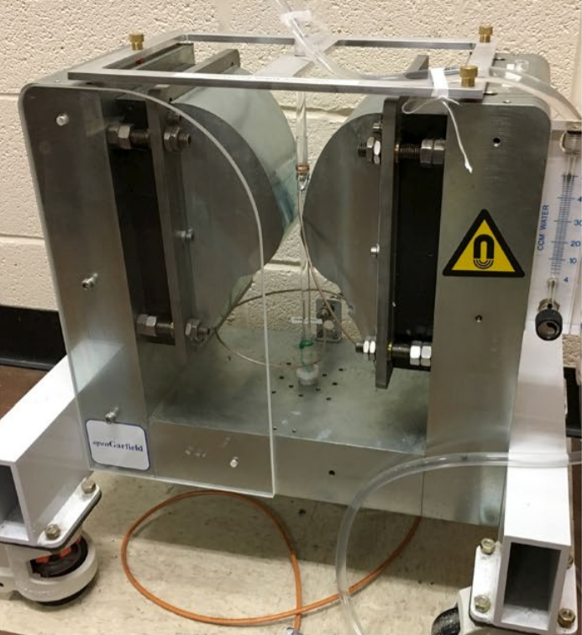
Introduction
Building a magnetic resonance device that can measure flow velocities.
Things like this have been done in the past with really large magnets which can be hazardous and quite expensive.
How does one go about constructing a low field, portable device that can achieve comparable data?
Richard, S., Newling, B. Measuring Flow Using a Permanent Magnet with a Large Constant Gradient
Notes:
-This is a completely non-invasive system
-By low field I simply mean much less then a conventional NMR system
-About 1000 times larger than earth’s magnetic field

Slide 3
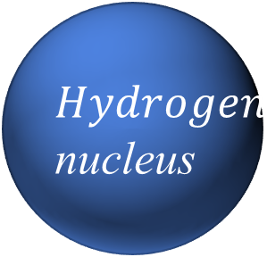
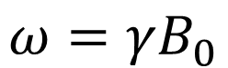
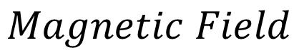
Basic Introduction to MR
$$Magnetic Field$$
Nuclear magnetic resonance is possible as nuclei possess angular momentum.
These nuclei can be thought of as miniature dipoles that will forced to point the direction of the applied magnetic field.
Due to their angular momentum, these nuclei will precess about the applied magnetic field at the Larmor frequency.
Transverse components of magnetization in the sample will cancel out.
$$Hydrogen$$
nucleus
$$ω=γB_{0}$$

Slide 4
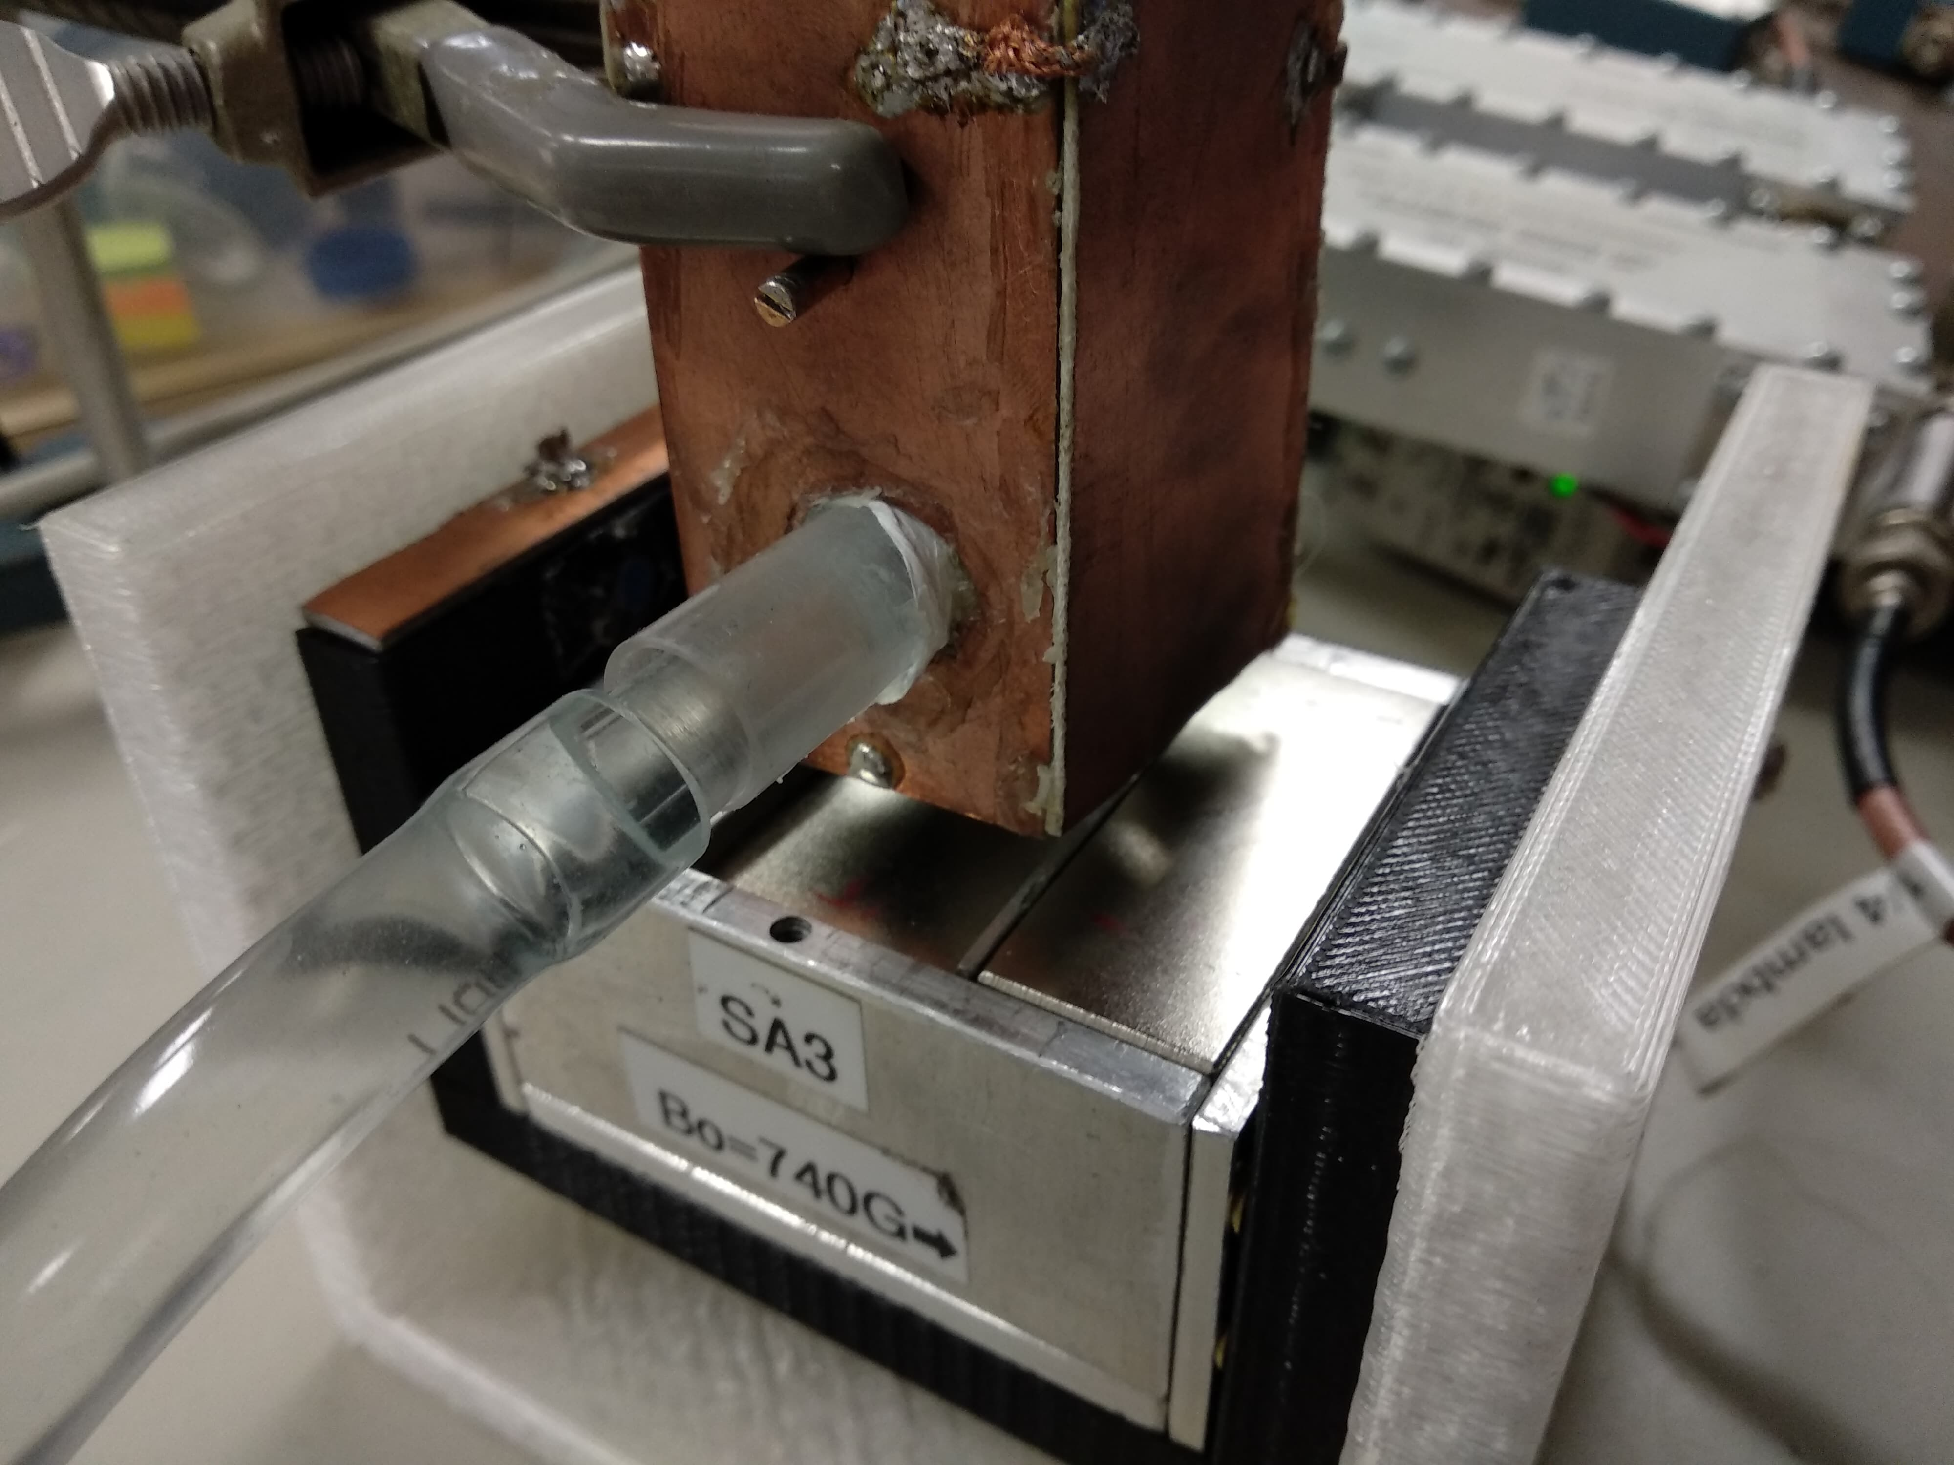

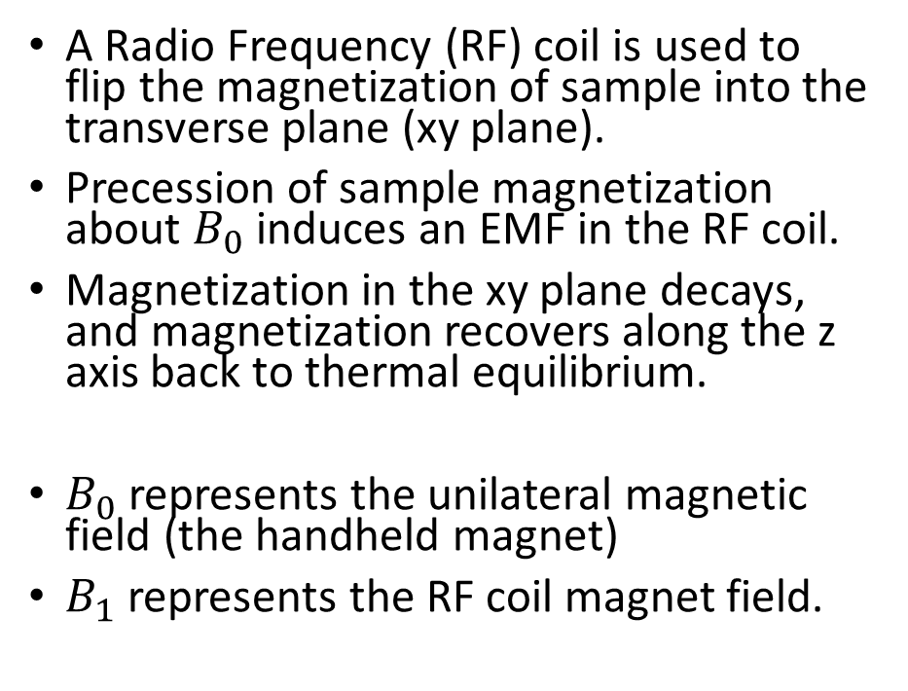





Pulse MR / Use of RF Coil
A Radio Frequency (RF) coil is used to flip the magnetization of sample into the transverse plane (xy plane).
Precession of sample magnetization about $B_{0}$ induces an EMF in the RF coil.
Magnetization in the xy plane decays, and magnetization recovers along the z axis back to thermal equilibrium.
$B_{0}$ represents the unilateral magnetic field (the handheld magnet)
$B_{1}$ represents the RF coil magnet field.
$$B_{1}$$
$${90}^{°}$$
$$B_{0}$$
$$x$$
$$z$$
$$y$$
Notes:
-The RF coil is in the shape of a solenoid
-The solenoid generates a magnetic field along B1

Slide 5
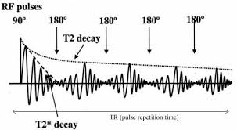
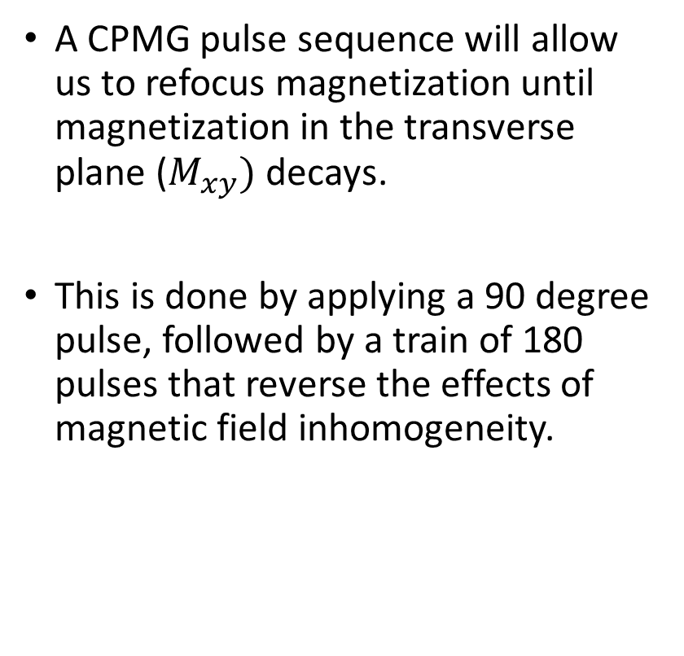
CPMG
A CPMG pulse sequence will allow us to refocus magnetization until magnetization in the transverse plane ($M_{xy})$ decays.
This is done by applying a 90 degree pulse, followed by a train of 180 pulses that reverse the effects of magnetic field inhomogeneity.
Received Signal Amplitude
http://www.jgmaas.com/SCA/2017/SCA2017-020.pdf

Slide 6
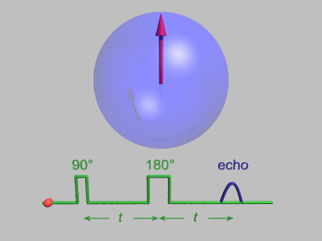
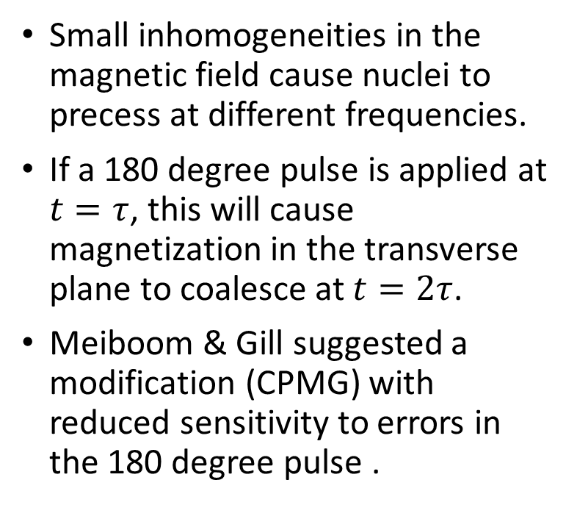
Carr-Purcell Echo
Small inhomogeneities in the magnetic field cause nuclei to precess at different frequencies.
If a 180 degree pulse is applied at $t=τ$, this will cause magnetization in the transverse plane to coalesce at $t=2τ$.
Meiboom & Gill suggested a modification (CPMG) with reduced sensitivity to errors in the 180 degree pulse .
https://en.wikipedia.org/wiki/Spin_echo
Notes:
-Red arrows in the figure describe spins of varying frequencies

Slide 7
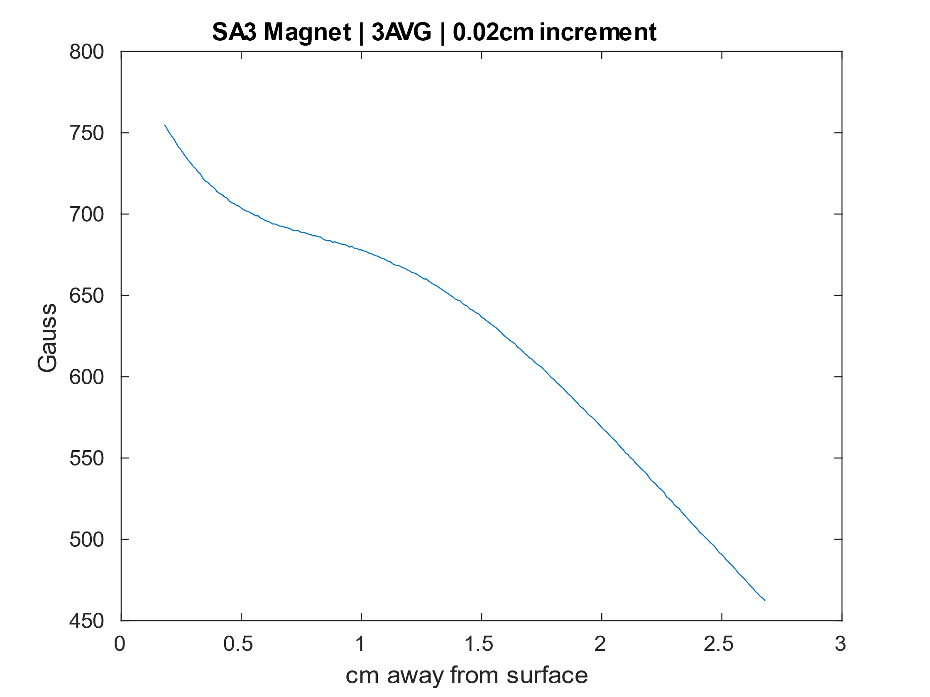
Handheld Unilateral Magnet
Cross Section of Unilateral
Magnet 1
Magnet 2
Magnet 3
530gauss at 2.25cm above surface of magnet
Sensitive region of 1cm

Slide 8
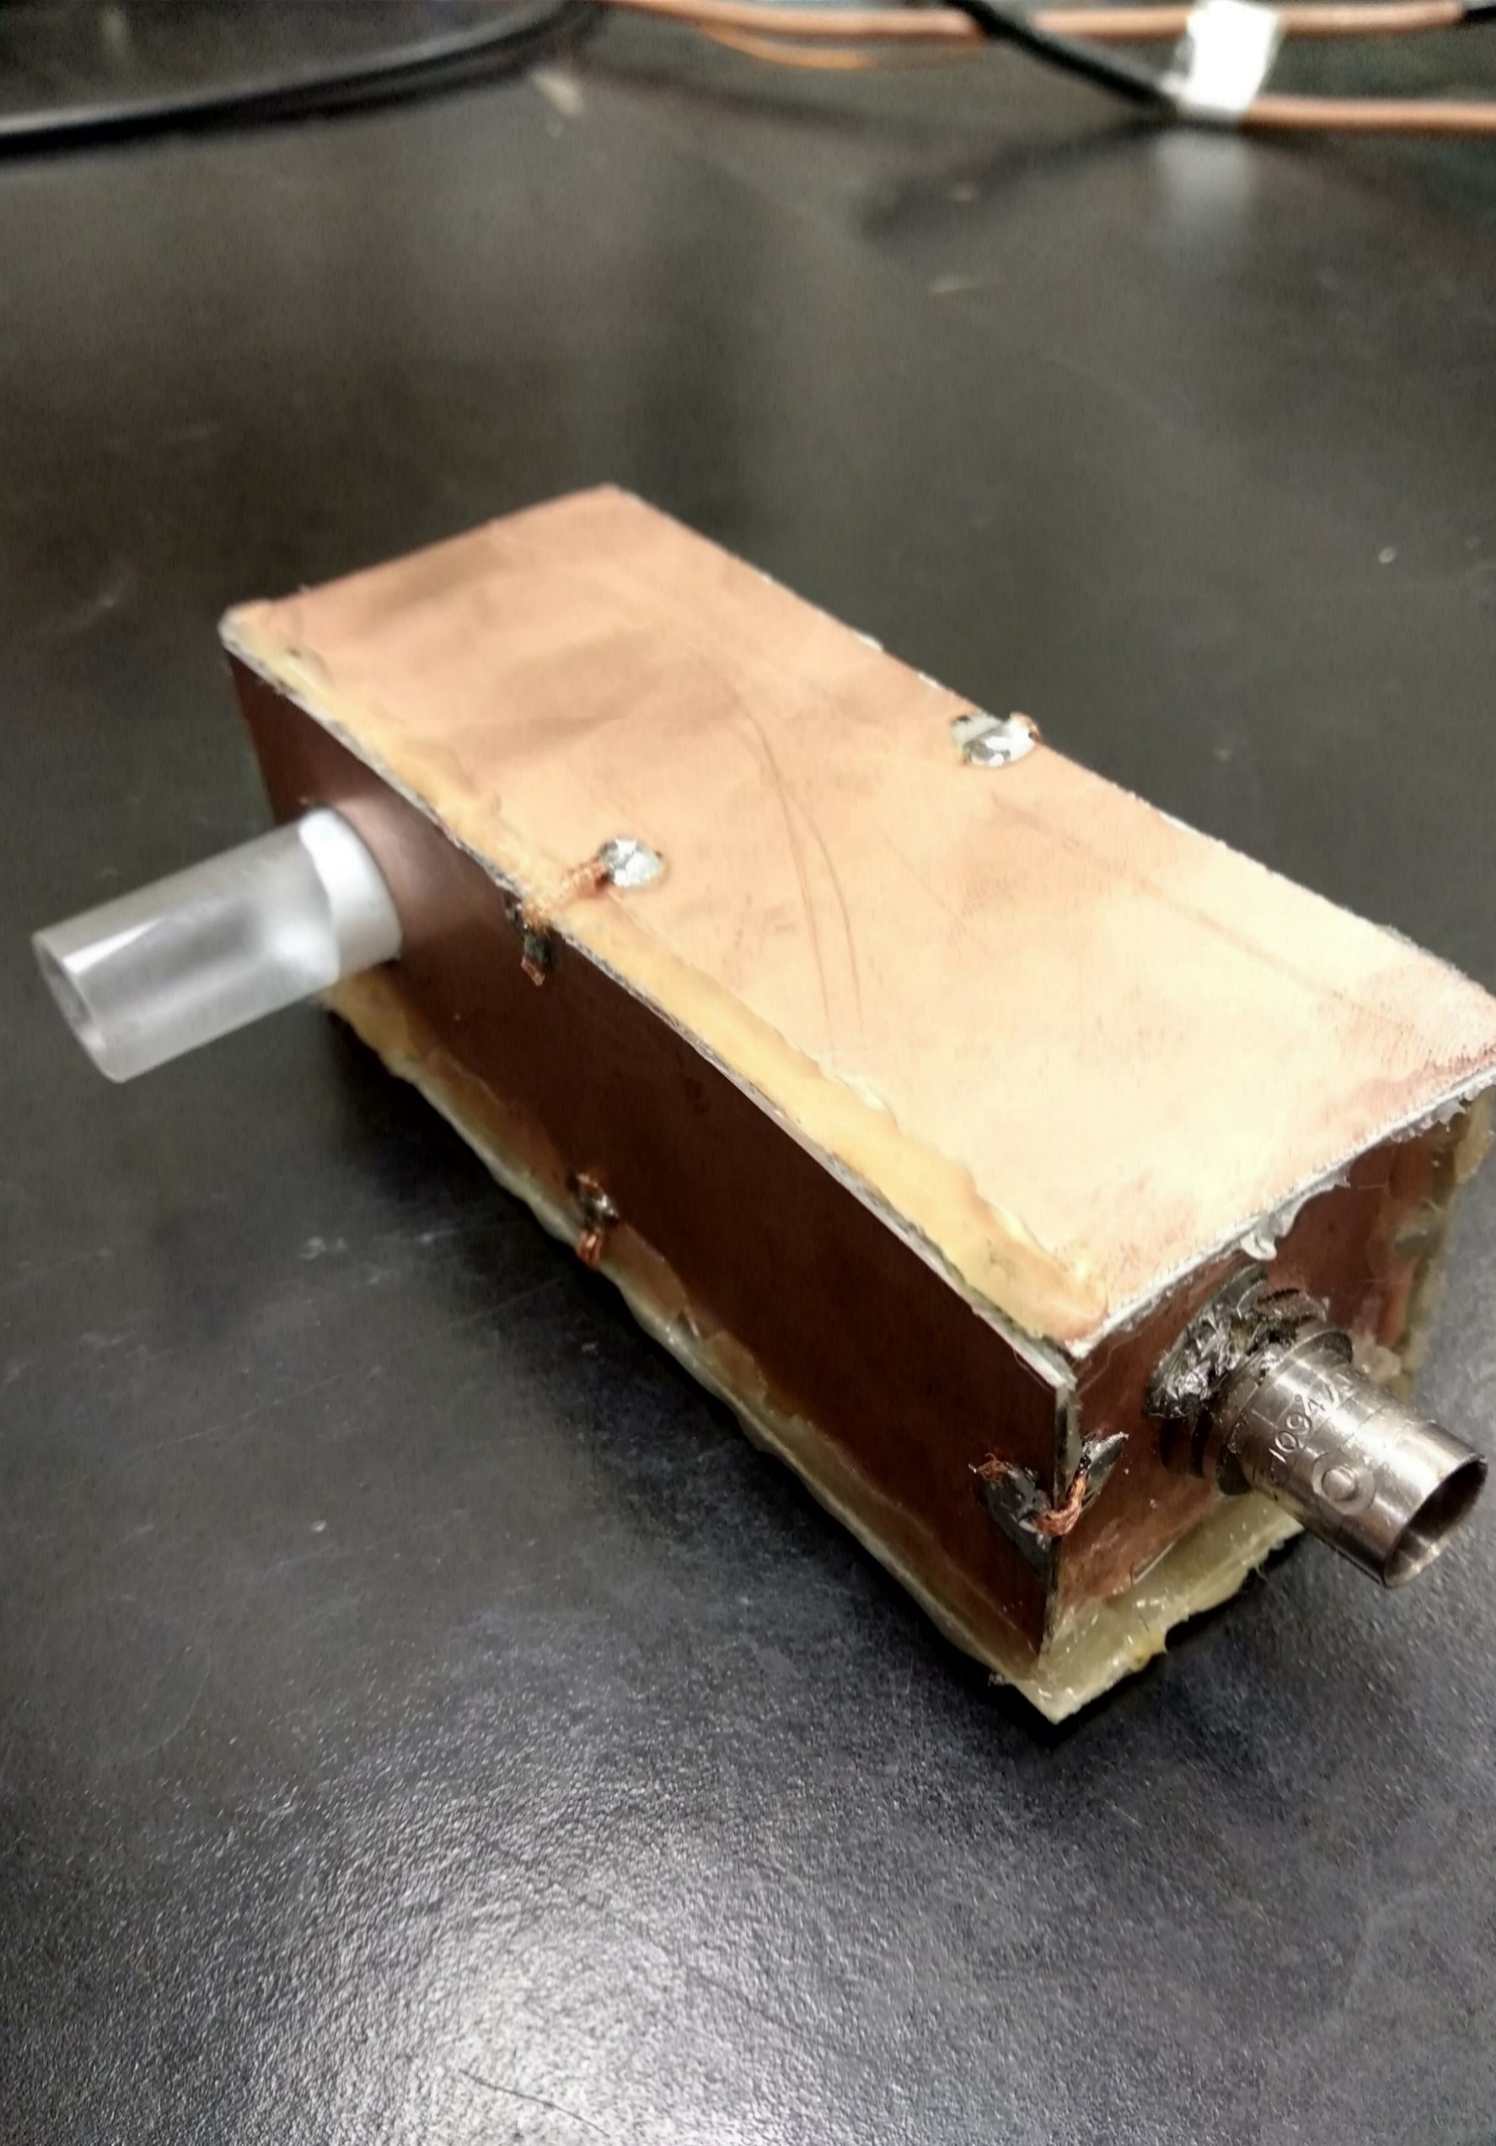
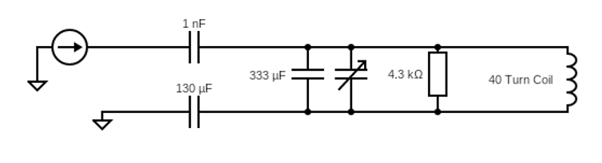
RF Probe Construction
A coil is wrapped around a plexiglass former , such that a secondary tube could be placed into the opening in the RF probe.
To reduce noise, a Faraday cage houses the circuitry.
Combination of both capacitively and inductively matched to 50Ω.

Slide 9
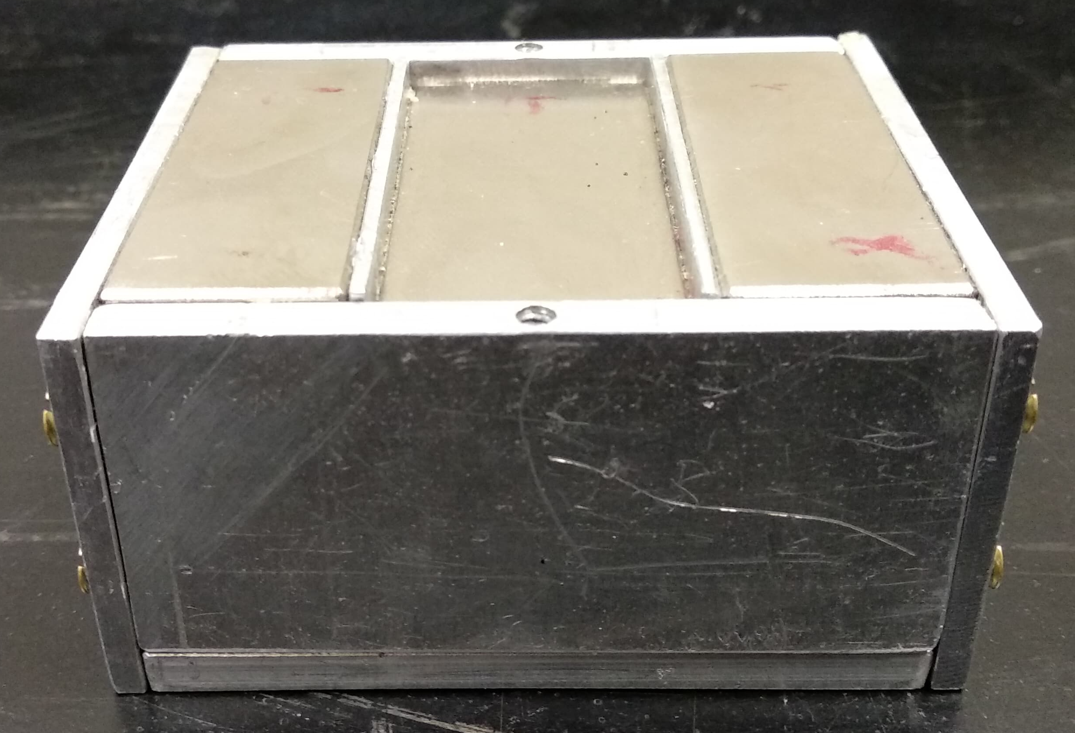
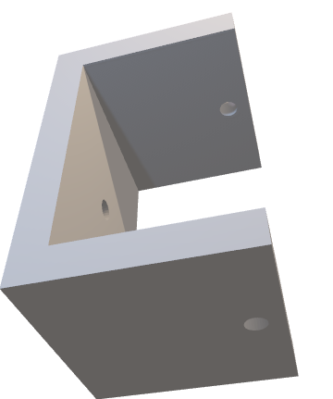
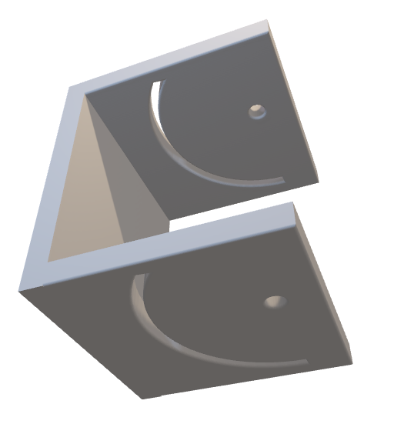
Unilateral Magnet & Cradle System
The magnet of choice is a small, handheld unilateral magnet with a constant gradient region at (2-2.5cm).
500 gauss (2.26MHz for Hydrogen) at 2.25cm above the surface.
A cradle system was 3D printed in order to change the relative angle of the magnet to allow for varying gradient strength which will change our slice thickness.
Notes:
-The sensitive slice will vary as the angle is changed

Slide 10
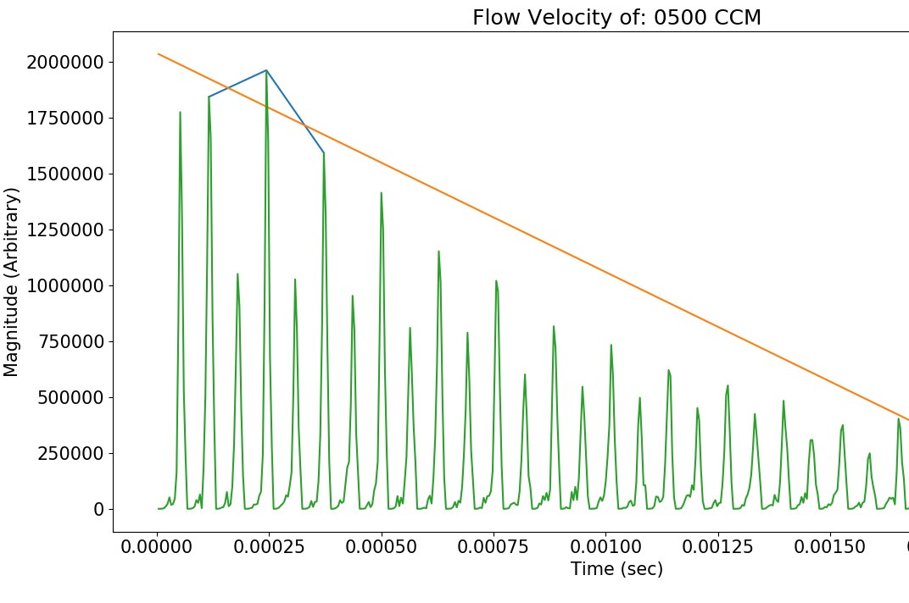
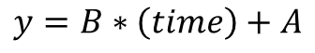
How to Measure Flow for CPMG
The early even echoes will roughly decay linearly. A relationship that can be shown mathematically.
Odd echoes are not used as their intensity is drastically decreased due to even echo rephasing.
The relationship between –B/A and flow velocity is linear. Where B is the slope of the linear fit, and A is the y-intercept.
$$y=B∗\left(time\right)+A$$
Notes:
Even echoes are used, odd echoes have greatly decreased magnitudes

Slide 11
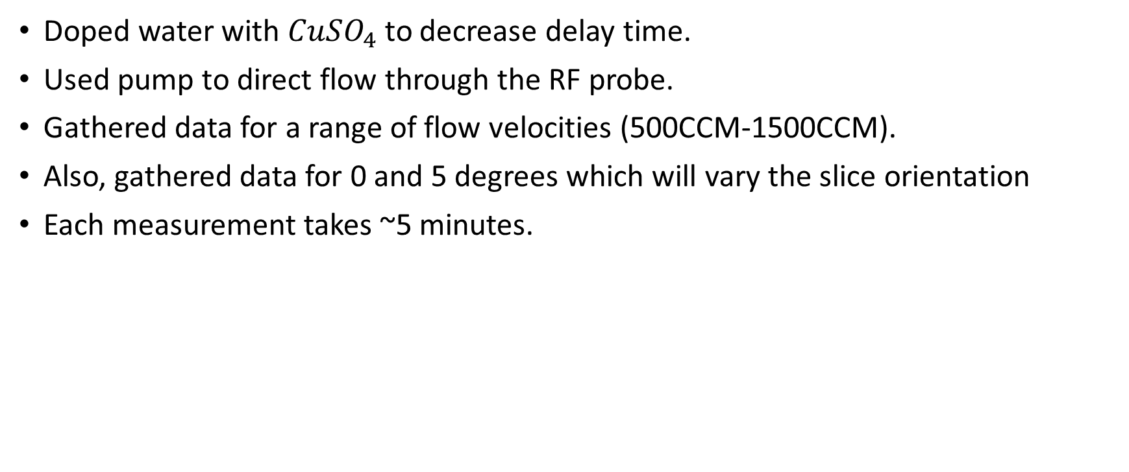
Methods
Doped water with $CuSO_{4}$ to decrease delay time.
Used pump to direct flow through the RF probe.
Gathered data for a range of flow velocities (500CCM-1500CCM).
Also, gathered data for 0 and 5 degrees which will vary the slice orientation
Each measurement takes ~5 minutes.

Slide 12
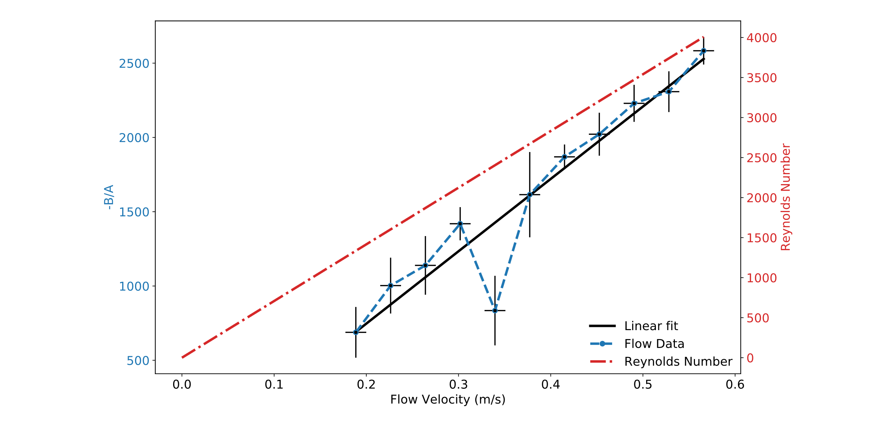
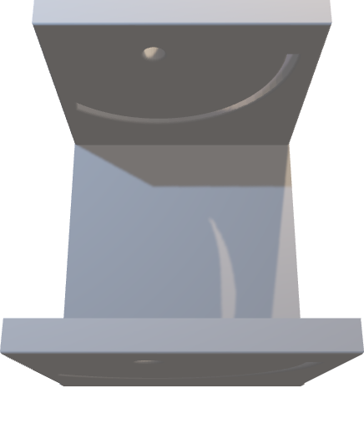
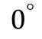

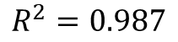
0 degree flow data
$$R^{2}=0.987$$
Cradle Orientation
$$0^{°}$$
Notes:
0 deg data

Slide 13
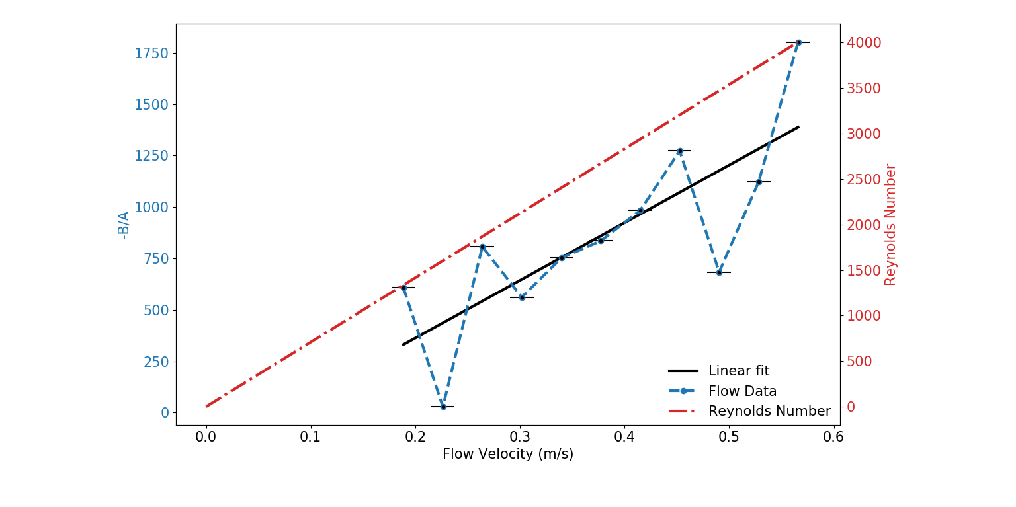
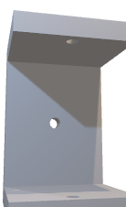
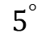
5 degree flow data
Cradle Orientation
$$5^{°}$$
Notes:
0 deg data

Slide 14
Conclusion
We have been able to show that measurements by fellow researchers in the lab are reproducible at low field using a small, affordable, portable magnet.
We have constructed a small magnetic resonance system that can measure flow velocities.
The cradle system allowed for variable slice orientation, and 0 degrees suggests that this is the optimum orientation for this measurement.

Slide 15
How to Improve the System
Better Faraday cage to reduce noise
Lower delay time by doping the water more
Filters that cut out as much noise as possible
MORE SCANS, MORE SCANS AND MORE SCANS
Functionally best at 0 deg; Get that sample as close as possible to the magnet! Increase magnetic field and increase signal.

Slide 16
Acknowledgements
Ben Newling ; Supervisor
Bruce Balcom ; Professor & Director of UNB MRI Centre
Andrés ; Research Scientist
AUPAC 2020 Organizers

